Slide 1
IEA-HTS-Exco, Milan
HTS Activity in China
Yutaka Yamada (SIT, IEA-HTS OA)
Jan. 30, 2016 at RSE, Milan, Italy
1
Notes:
Today I would like to introduce “HTS Road Map for Power Applications”, which was done by IEA-HTS-IA.
Here are the authors, me, xxx, yyy, and the committee members of IEA-HTS-IA.

Slide 2
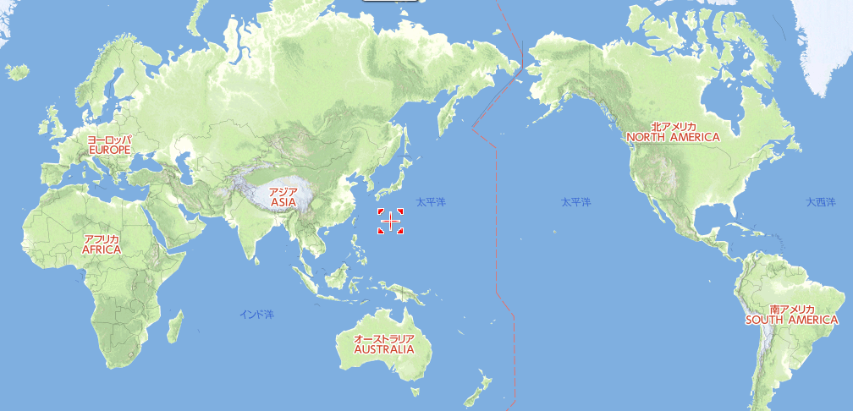
HTS
EU
Korea
China

Slide 3
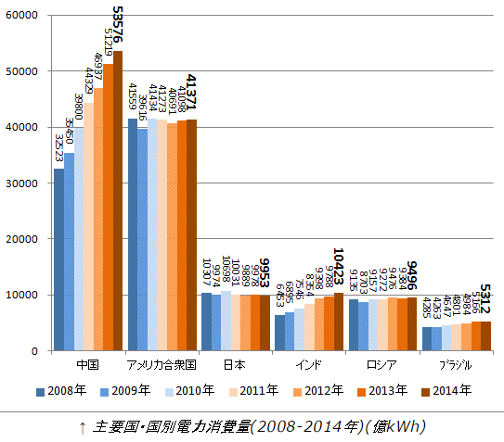
Electric Power Consumption for the past decade
“Key World Energy Statistics 2016” in IEA - Free publications
Increase in China doubles that in Japan.
Electric Power Consumption (100milion kWh)
China
US
Japan
India
Russia
Brazil

Slide 4
R&D Programs for Superconductivity in China
1.National High Technology Research and Development Program (863 Program)
Main goals:
Manufacture technology of Superconducting materials for practical applications.
Superconducting technology: cable, FCL, magnet, and filter.
Main Projects including:
-- Manufacture techniques of high-performance Coated Conductor superconducting tapes
-- Manufacture techniques of superconducting strands for high-performance MRI application
-- Nb3Sn superconducting wires for high-field application
-- large capbility HTS Superconducting cables
-- High voltage level superconducting FCL
Principal Investigator: Prof. Pingxiang Zhang
Total fund: 200 Million RMB (FY2011-FY2015) to 32 groups with more than 300 researchers.
～15MUS$
～100MUS$ including other 4 programs
Notes:
For those who may not know alstom let me give you few intoductory words on our company

Slide 5
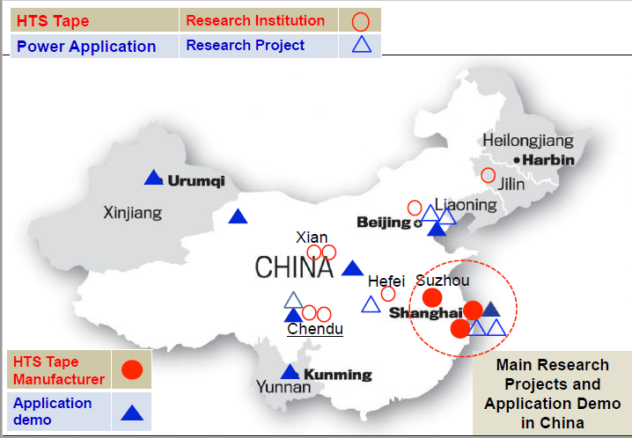
China HTS Activity
Prf. Cai of Shanghai Univ.

Slide 6
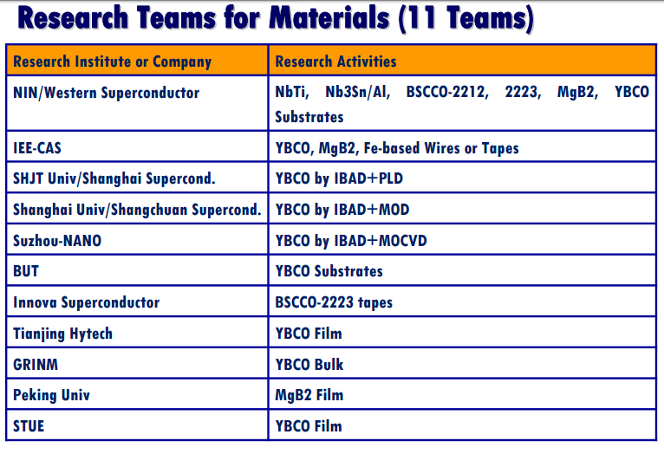
China
Dr. Xiao of CAS, Beijing

Slide 7
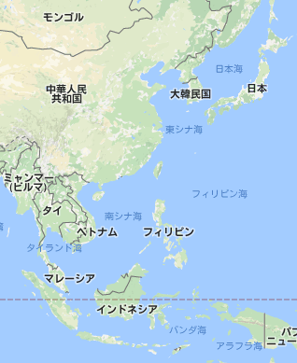
Visit to Shanghai and Xian
0.5億人
1.2億人
14億人
0.7億人
1億人
1億人
0.3億人
2.6億人

Slide 8
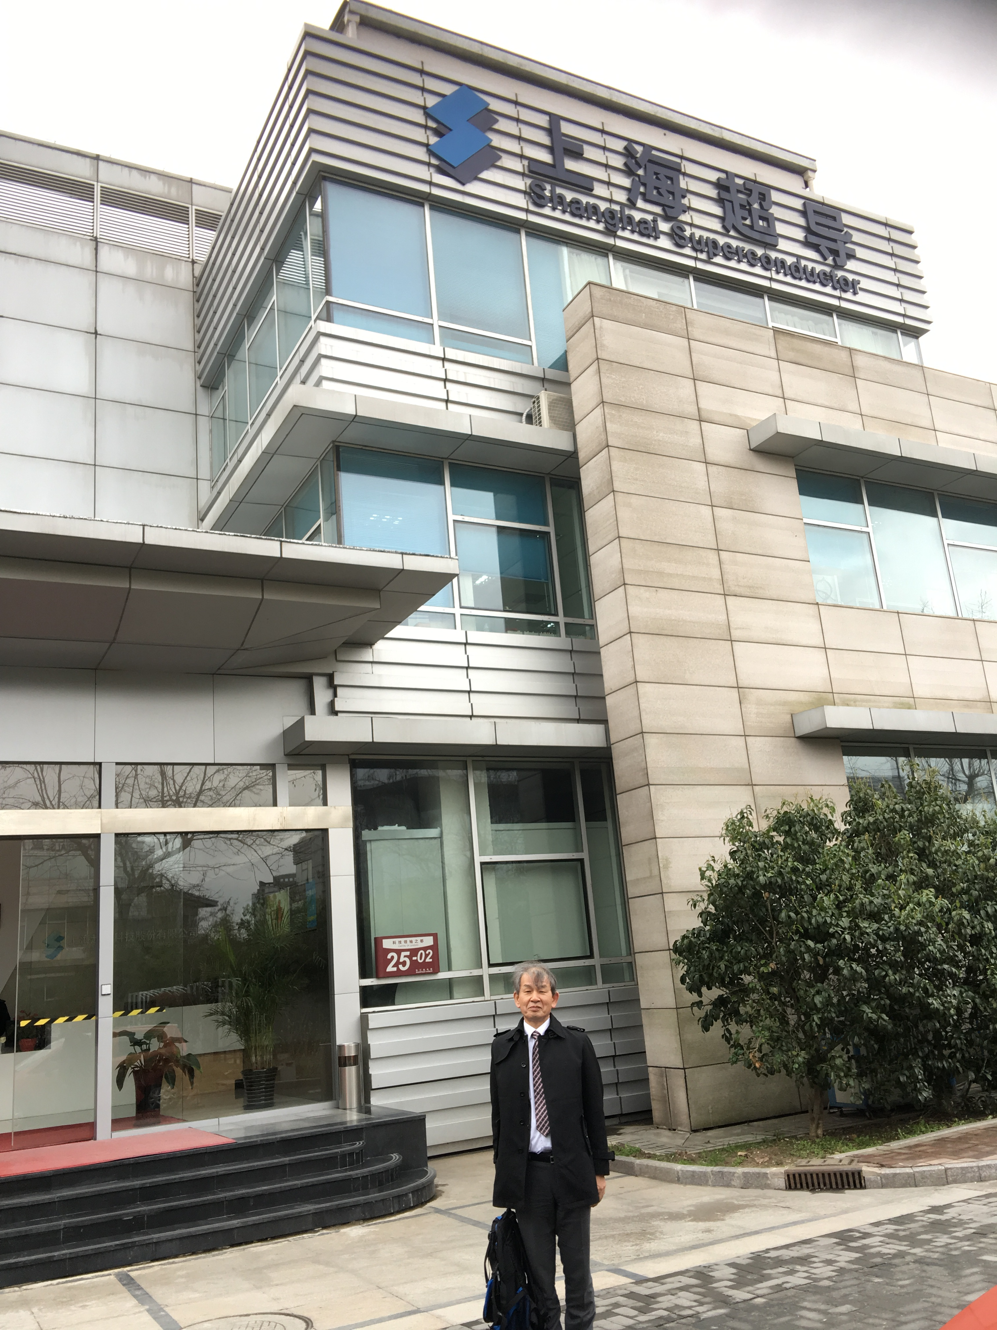
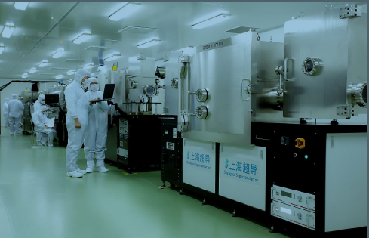
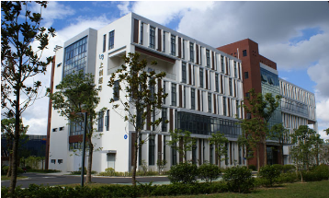
Visit China: Shanghai, Xian
SSTC in Shanghai.
SSTC in Shanghai.
SCSTC in Shanghai.

Slide 9
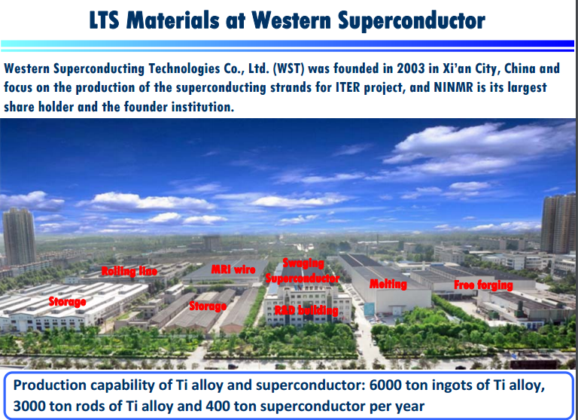
NIN and West Superconductor:Nb3Sn, Bi2212, 2223, MgB2…..
Prof. Zhang of NIN, Xian

Slide 10
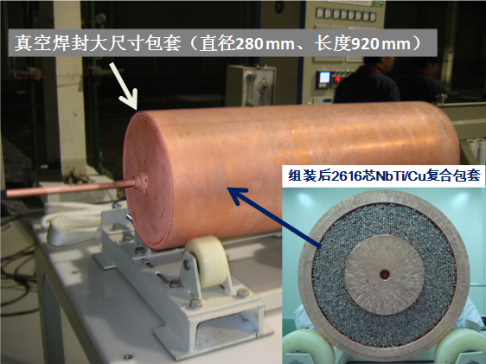
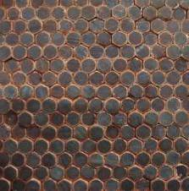
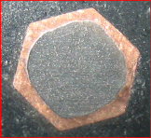
Fabrication of large size NbTi/Cu composite billet
Cu
NbTi
Nb
Subelements
Single filament
Cu
450kg billlet with 2616 filaments in one step assembly process. Fill ration reaches 98%.
Cu stablizer
WST developed the fabrication technology to make large size NbTi/Cu billet with high quality long wires

Slide 11
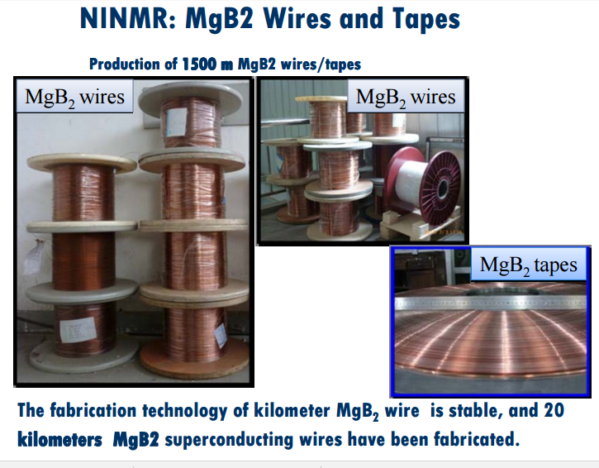

Slide 12
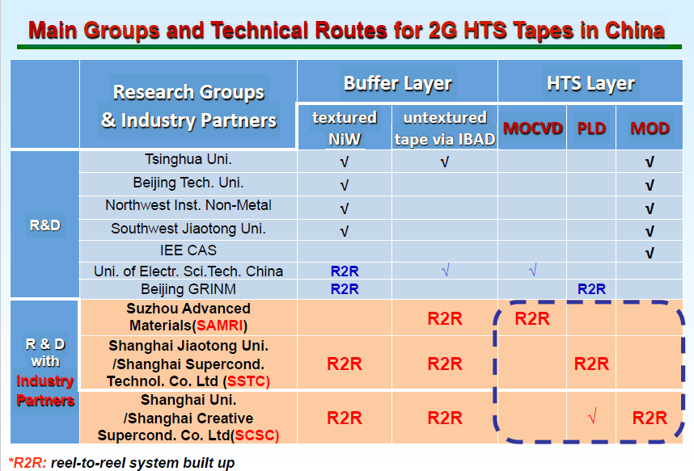
CC of China
Prf. Cai of Shanghai Univ.

Slide 13
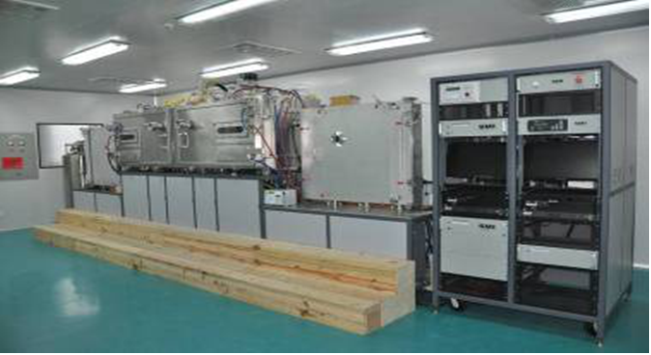
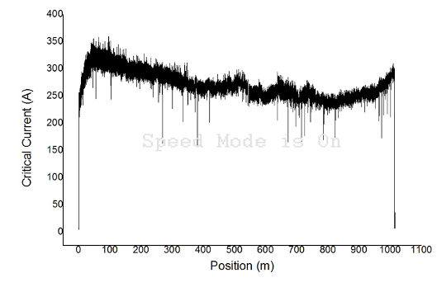
Development of km-level YBCO CC by MOCVD/PLD
4. MOCVD-YBCO layer deposition technology
Capability > 1000m Width of tape 12mm
Speed：50 -100 m/h Thickness of YBCO 1-3 μm
Ic=280 A/cm-width @77K
The MOCVD system can deposit 1-3μm YBCO layer with sharp texture on km-level IBAD-MgO layer.

Slide 14
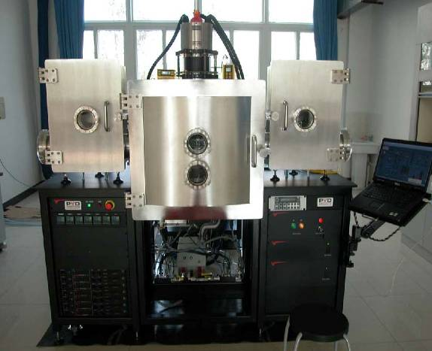
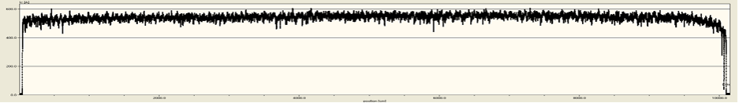
SSTC, Shanghai Jiao ton Univ.
5. PLD-YBCO layer deposition technology
Ic=500 A/cm-width @77K
The PLD system can deposit 1-3μm YBCO layer with sharp texture on 500m-level IBAD-MgO layer.

Slide 15
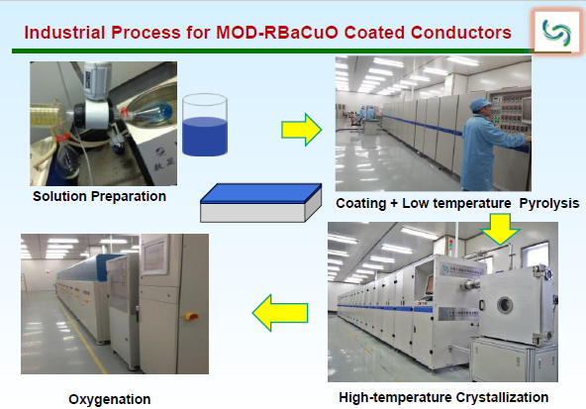
SCSTC, Shanghai Univ.
Prf. Cai of Shanghai Univ.

Slide 16
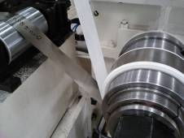
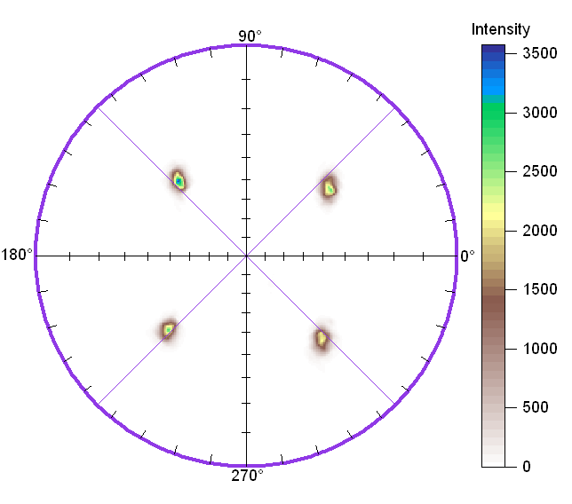
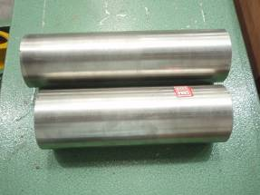
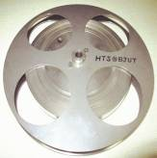
Long-length & Textured Ni5W，Ni7W and Ni9W tapes for CC
at NIN, West Superconductor
NiW-alloy ingot
Thickness~66 μm
Width=10 mm
Length>500 m
Sharp cube textured (~100%) Ni5W tapes with the level of hundred meters were obtained by conventional metallurgy method.
Content of cube texture in Ni7W and Ni9W tapes reaches 99.5% and 94% respectively.

Slide 17
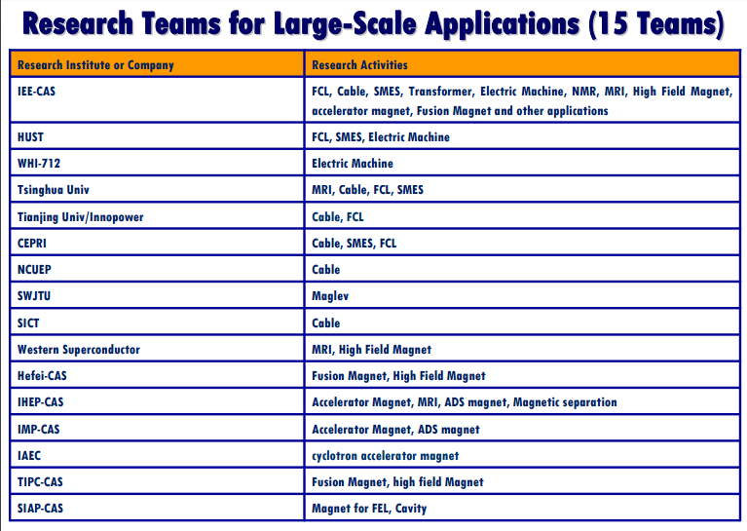
Cable, FCL and MRI are active.
Dr. Xiao of CAS, Beijing

Slide 18
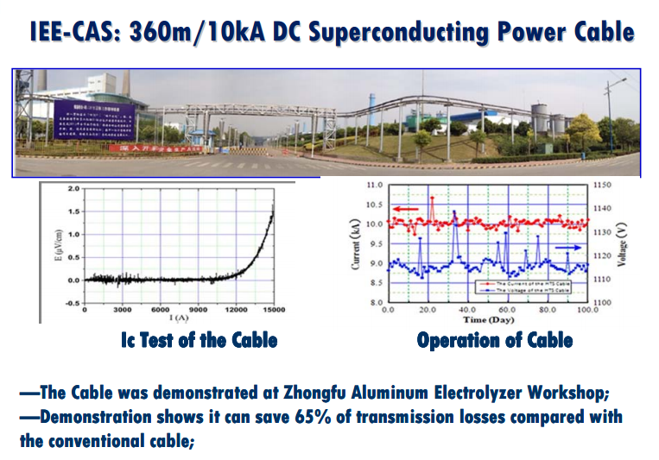
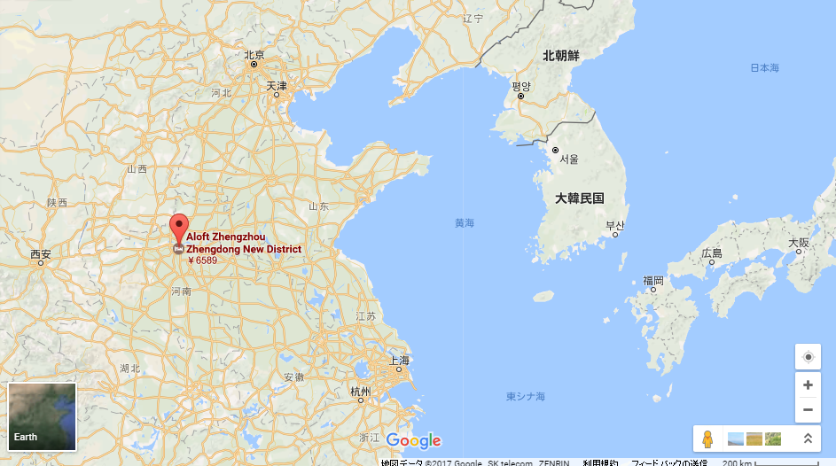
With the sophisticated hot rolling line, cold rolling line and foil processing line as well as inspection facilities, most of its equipment are advanced nationally and some of even worldwide. It’s designed out put is 200,000 tons per year.

Slide 19
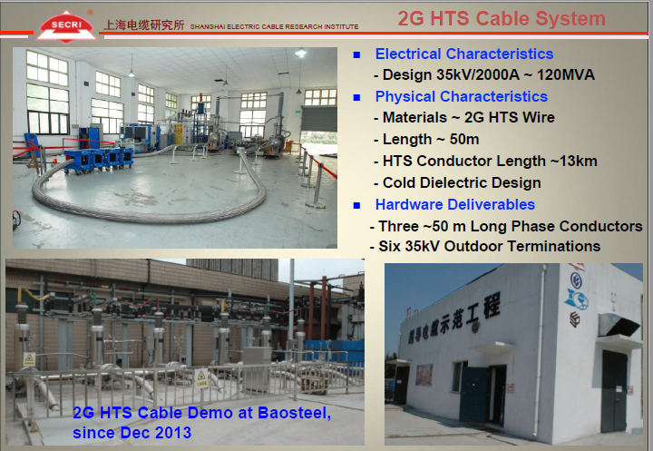

Slide 20
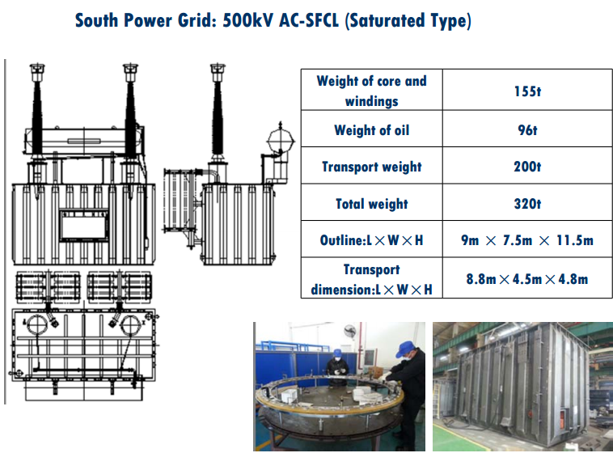
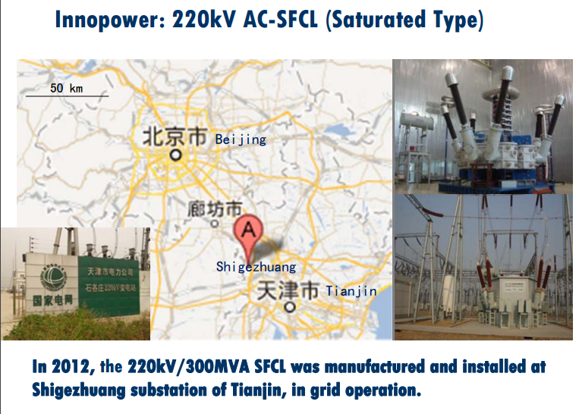
FCL from low to high voltage

Slide 21
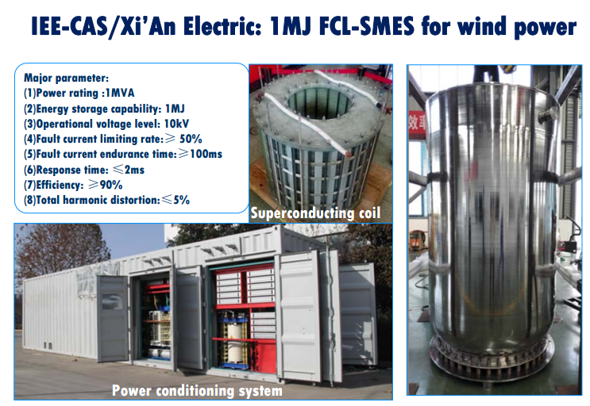

Slide 22
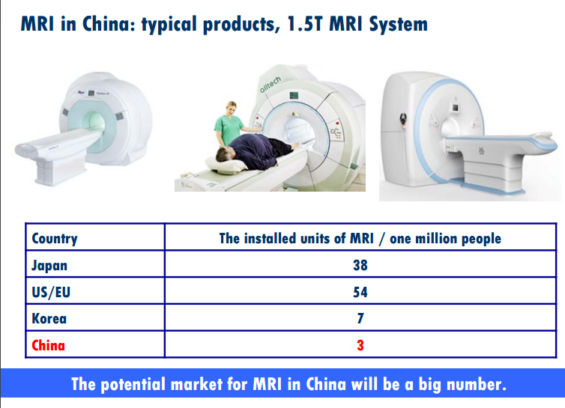
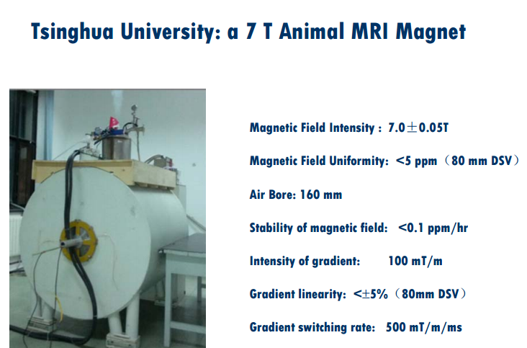

Slide 23
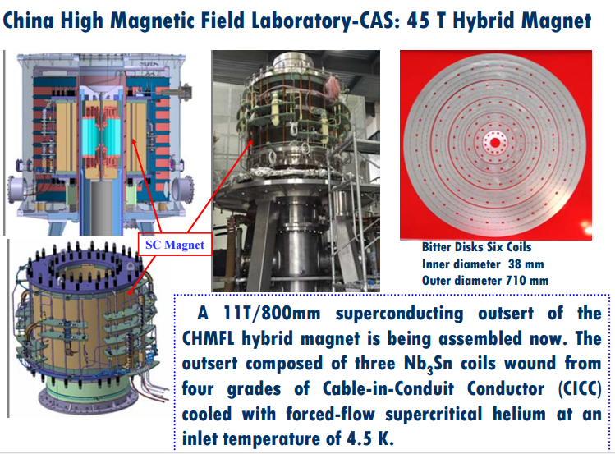
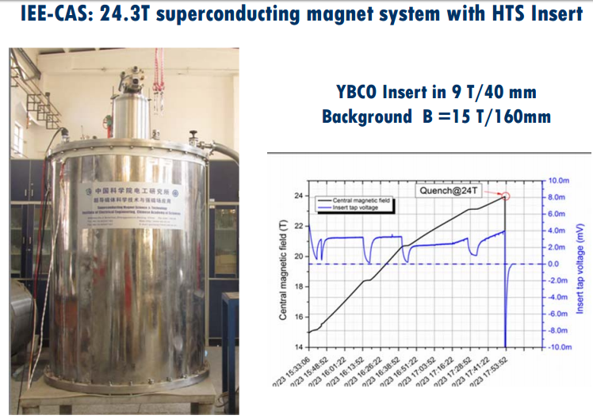

Slide 24
Progress of SC and its application in China (2011-2015)
Materials
YBCO CC: 50m, Ic=140A@77K
Laboratory scale
YBCO CC: 1000m, Ic=280A@77K
Industry scale
LTS：
Starting mass production
180t NbTi and 30t Nb₃Sn strands for ITER, 100t strands for MRI and HEP application
2011
2012
2013
2014
2015
Application
Power DEMO：HTS Power Substation
Cable：
380m, 10000A DC
FCL：
220kV, 3 Phase
FCL：
550kV, 3 Phase
The R&D of superconducting materials and applications in China cover all the fields today.
Prf. Zhang of NIN, Xian.

Slide 25
Summary
/ Up to now, 100MUS$ invested for 2011 to 2015
/ Wire produced from LTS to HST (Bi2223, 2212, YBCO, MgB2)
in the areas of Shanghai for YBCO
Xian for LTS, Bi, MgB2
/ Active Application
Cable, FCL
MRI for the market in the near future
/ Further investment will be expected also after 2016.

